Slide 1
Setting Up a Pedestrian Safety Enforcement Operation
Presented by
Sergeant Jonathan Hardy
Salem police department

Slide 2
Purpose
  To increase the safety of pedestrians crossing the roadway in the community where the action takes place.

Slide 3
How this is accomplished
Through a combination of:
    News Media Releases
    Pedestrian Safety Enforcement operations

Slide 4
Results
  The number of pedestrian safety violations will be reduced by a combination of news releases and word of mouth from the violators, other motorists and citizens

Slide 5
How to Begin
Minimum of four (4) persons.
    6 or more are ideal
    1 to 2 will be in plain clothes
Four Person Detail –
    Spotter
    Decoy
    2 chase cars
The number of personnel may vary depending upon the location of the operation.
    News media may be invited to observe
Personnel

Slide 6

How to Begin
Radios
  Operation can be done without radio for decoy as long as there is verbal contact with the spotter to advise of any anomalies in the violation.
Chase Vehicles
    Patrol cars and motorcycles
Orange Cones
    2 Large
Radar Unit
Video Camera
Log Sheet
Pedestrian Handout
PSE Display Boards
Equipment

Slide 7
How to Begin
To ensure safety for both the decoy and for the motorist, this operation will follow the listed criteria:
Preparation

Slide 8
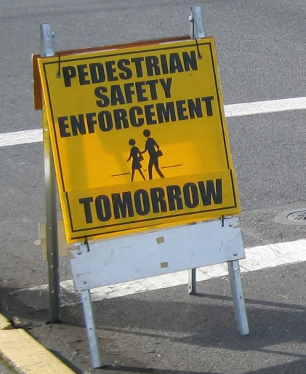
How to Begin
One week prior
  A news release outlining the purpose and goals of the operation will be provided and include the following:
        Date
        Time
        Location
  AND
  Twenty-four hours prior to operation, PSE boards to be placed at detail location.
Preparation

Slide 9
How to Begin
Example of a news release:
From: info@flashalert.net [mailto:info@flashalert.net]
Sent: August 17, 2017 10:37 AM
To:
Subject: Beaverton Police Conduct Traffic Enforcement Details
Importance: High
News Release from: Beaverton Police Dept.
BEAVERTON POLICE CONDUCT TRAFFIC ENFORCEMENT DETAILS
Posted: August 12th, 2017 10:34 AM
Traffic safety is important to all of us, and dedicated education, enforcement, and responsible and aware drivers are a big part of roadway safety.
Pedestrian safety on and near roadways requires extra attention. The Hillsboro Police Department is conducting pedestrian enforcement details on August 17 and 26, 2017, at different locations around Beaverton.
The public is reminded to use this time and everyday to see pedestrians and slow down.
Beaverton Police will also conduct seat belt enforcement details August 30th, 2017
Drive safe, be safe, and enjoy the rest of this summer season.
Contact Info: Sgt Steve Schaer
SSchaer@beavertonoregon.gov
503-526-2260
Preparation

Slide 10
How to Begin
This operation is done only in daylight hours and during fair weather conditions (little or no rain).
The operation can be conducted in marked or un-marked crosswalks.
The decoy will use due care and not endanger him/herself or motorists.
Preparation

Slide 11
How to Begin
The required stopping distance for the vehicles will be measured out based on 10 MPH over the posted limit.
Included in this will be a 2 second PRT (perception reaction time).
Preparation

Slide 12


Distance Required for a Vehicle to stop for Pedestrian
Speed Limit Excess Speed
25 MPH + 10 MPH = 35 MPH
Formula for Distance:
Distance Calculation: = 58.3 feet to stop at 35 MPH
Add 2 second reaction time of: Speed (1.466) = 35(1.466) * 2 = 102.6 ft
58.3 feet + 102.6 feet = 160.9 feet
Therefore, the total distance to stop is approximately:
161 feet at 35 MPH (25 mph road)

Slide 13
Stopping Distance Comparison
MPH | Ft / Second | Braking Deceleration Distance | Perception Reaction Distance 1.6 | Total Stopping Distance |  | Perception Reaction Distance 2.0 | Total Stopping Distance
10 | 14.7 | 4.8 | 23.5 | 28.2 |  | 29.3 | 34.1
15 | 22.0 | 10.7 | 35.2 | 45.9 |  | 44.0 | 54.7
20 | 29.3 | 19.0 | 46.9 | 66.0 |  | 58.6 | 77.7
25 | 36.7 | 29.8 | 58.6 | 88.4 |  | 73.3 | 103.1
30 | 44.0 | 42.9 | 70.4 | 113.2 |  | 88.0 | 130.8
35 | 51.3 | 58.3 | 82.1 | 140.4 |  | 102.6 | 161.0
40 | 58.6 | 76.2 | 93.8 | 170.0 |  | 117.3 | 193.5
45 | 66.0 | 96.4 | 105.6 | 202.0 |  | 131.9 | 228.4
50 | 73.3 | 119.0 | 117.3 | 236.3 |  | 146.6 | 265.6
55 | 80.6 | 144.0 | 129.0 | 273.1 |  | 161.3 | 305.3
60 | 88.0 | 171.4 | 140.7 | 312.2 |  | 175.9 | 347.3
65 | 95.3 | 201.2 | 152.5 | 353.7 |  | 190.6 | 391.8

Slide 14
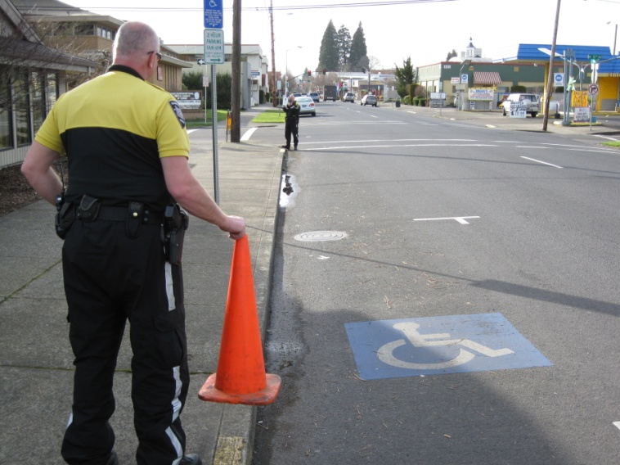
How to Begin
Setting up
  One cone will be placed at the beginning of the measured stopping distance. It is measured out to a safe stopping distance of a vehicle traveling at 10 MPH over the speed limit.
Preparation

Slide 15
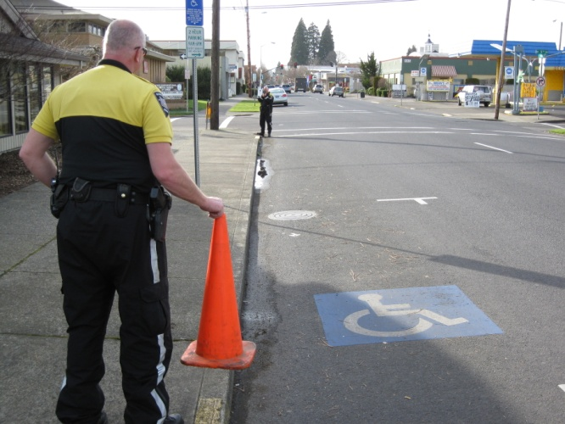
How to Begin
Setting up
  Stopping Distances
    Posted 20 mph 131’
    Posted 25 mph 161’
    Posted 30 mph 194’
    Posted 35 mph 228’
    Posted 40 mph 266”
    Posted 45mph 305’
Preparation

Slide 16
Setting up a PSE Operation
25 MPH + 10 MPH = 35 MPH + 2 second reaction time = 161’
161’
161’
cone
Crosswalk
Car A >
cone
In this case the posted speed limit is 25 MPH so the safe stopping distance for a car traveling at 35 MPH and a 2 second reaction time is 161’.

Slide 17
How to Begin
Setting up
  The decoy will wear clothing which is conspicuous (bright or light colored that don’t blend in with the background)
  If available, a video camera will be setup near the crosswalk to allow for recording of the offense.
Preparation

Slide 18
How to Begin
Setting up
  If possible, the chase vehicles will have radar to record the speed of the violators.
  The chase vehicles will be posted out of sight a block or two from the location of the operation.
Preparation

Slide 19
How to Begin
Setting up
  A spotter will be in a position to observe the violations, to document violations and radio the chase vehicles.
  Other options are to conduct operations targeting vehicles making right or left hand turns at controlled intersections and crosswalks.
Preparation

Slide 20
The Operation
The Decoy
    The decoy pedestrian will cross back and forth in the crosswalk when safe to do so.
    Also have the decoy record the number of times that he/she crosses the roadway

Slide 21
Setting up a PSE Operation
161’
161’
cone
Crosswalk
Car A >
cone
The pedestrian decoy enters the crosswalk as the vehicle approaches the cone, but before the vehicle enters the shaded area.
If the vehicle does not stop and yield to the pedestrian decoy, they would be cited. If the vehicle were in the shaded area at the time of the decoy entering the crosswalk, they would receive a verbal warning.

Slide 22
Setting up a PSE Operation
161’
161’
cone
Car A >
Crosswalk
Car B>
cone
88’
If car “B” is traveling at the posted speed and with normal reaction time of 1.6 seconds, the vehicle would be able to safely stop in 88’, leaving a safe distance of 73’ to the crosswalk.

Slide 23
The Operation
The Spotter
  The spotter will radio the vehicle description, violation and lane position to the chase vehicle.
  The spotter will keep a log of the vehicle descriptions and violations as they occur.
  This information will be used to match up citations to the violations seen by the spotter.

Slide 25
The Operation
In this kind of set-up there are 2 possible results:
  The vehicle stops correctly and yields to the pedestrian.
  The vehicle disregards the pedestrian and fails to yield. Factors for this include:
  -speed of vehicle
  -inattention of driver
  -improper lane usage

Slide 26
The Operation
The Citation:
Offer violator a pedestrian handout.
Offer violator video scheduling handout (in order to have the offending driver view the violation).
Offer information on Diversion Class.
Offer court options
Communicate the importance of the detail

Slide 27
Example of Handout
VIDEO SCHEDULING
If you wish to view the recorded violation prior to your scheduled court date, please contact Officer Name Here at (503) 681-xxxx x417. The date set for the viewing will be May 2, 2017 between 9:00am and 10:00am. When calling, please leave your name, phone number and citation number located in the upper right hand corner of the citation.

Slide 28
The Operation
A memo may be written summarizing the operation, personnel present and the results.
Time length for the operation:
    2 to 2.5 hours of actual enforcement

